Slide 1
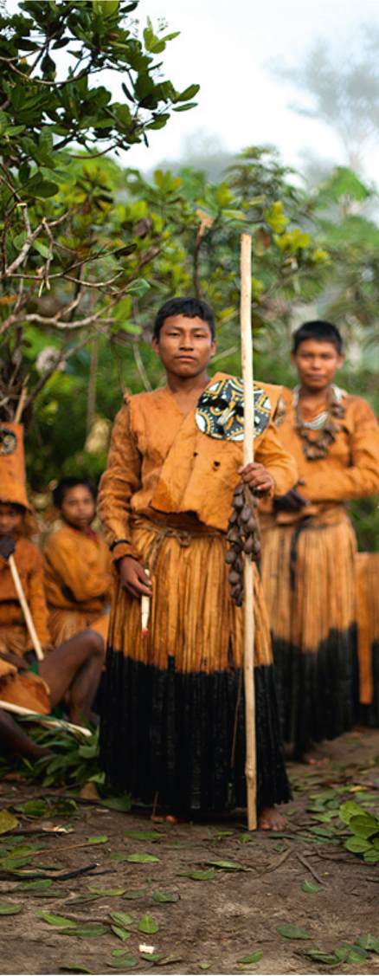
Definitions have consequences: Taking seriously the 2003 Convention for the Safeguarding of the Intangible Cultural Heritage Frank Proschan
Smithsonian Institution
27 January 2015

Slide 2
What is the 2003 Convention? And why does it matter?
The 2003 Convention changes the rules of the game for living heritage:
Redefines key concepts (intangible cultural heritage and safeguarding)
Revolutionizes relations between communities concerned with intangible cultural heritage and everyone else (governments, experts, organizations)

Slide 3
Taking the Convention seriously
Landmarks along the journey
Arriving at a definition
Definitions have consequences
Discussion

Slide 4
Landmarks along the journey
1973-2003

Slide 5
Landmarks along the journey: 1973-2003
1973 Bolivian proposal for an international instrument:
expresiones culturales de creación colectiva o cuyos autores no se identifican (cultural expressions of collective or anonymous origin)
creación colectiva o creación anónima (works of collective or anonymous authorship)

Slide 6
Landmarks along the journey: 1973-2003
1973 Bolivian proposal for an international instrument:
culturas tradicionales (traditional cultures)
acervo folklórico (heritage of folk arts)
cultura artística tradicional de los pueblos (traditional artistic culture of the peoples)
expresiones folklóricas (folk art forms)
artes populares (national cultural heritages)
folklore (folklore)
bienes culturales folklóricos (folkloristic cultural property)

Slide 7
Landmarks along the journey: 1973-2003
1984 UNESCO meeting on ‘non-physical heritage’:
‘“Non-physical heritage,” “popular traditions,” and “folklore” all share four common precepts:
1) the collective and spontaneous participation in the traditions by the community;
2) the impersonal or anonymous origin of the traditions:
3) the non-commercial and largely unwritten means of transmission; and
4) the tradition’s core structure and techniques which have passed across generations.’

Slide 8
Landmarks along the journey: 1973-2003
1989 UNESCO Recommendation:
‘Folklore (or traditional and popular culture) is the totality of tradition-based creations of a cultural community, expressed by a group of individuals and recognized as reflecting the expectations of a community in so far as they reflect its cultural and social identity; its standards and values are transmitted orally, by imitation or by other means. Its forms are, among others, language, literature, music, dance, games, mythology, rituals, customs, handicrafts, architecture and other arts.’

Slide 9
Landmarks along the journey: 1973-2003
1989 UNESCO Recommendation:
States are to guarantee communities have access to their own heritage
States are to ensure that ‘various interested parties (communities or natural or legal persons) enjoy the economic, moral and so-called neighbouring rights’ of their creations

Slide 10
Landmarks along the journey: 1973-2003
1998: the birth of ‘masterpieces’
‘The space or form of cultural expression proclaimed a masterpiece of the oral heritage of humanity must be of outstanding universal value in that it represents:
(a) either a strong concentration of the intangible cultural heritage of outstanding universal value; or
(b) a popular and traditional oral expression of outstanding universal value from a historical, artistic, ethnological, sociological, anthropological, linguistic or literary point of view.’

Slide 11
Landmarks along the journey: 1973-2003
1998: the birth of ‘masterpieces’
‘The space or form of cultural expression proclaimed a masterpiece of the oral heritage of humanity must be of outstanding universal value in that it represents:
(a) either a strong concentration of the intangible cultural heritage of outstanding universal value; or
(b) a popular and traditional oral cultural expression of outstanding universal value from a historical, artistic, ethnological, sociological, anthropological, linguistic or literary point of view.’

Slide 12
Landmarks along the journey: 1973-2003
1998: the ‘masterpieces’ criteria
outstanding value as a masterpiece of the human creative genius;
roots in the cultural tradition or cultural history of the community concerned;
role as a means of affirming the cultural identity of the peoples and cultural communities concerned;
excellence in the application of the skill and technical qualities displayed;
value as a unique testimony of a living cultural tradition; etc.

Slide 13
Landmarks along the journey: 1973-2003
1999 Washington Conference
need for a new international instrument
primacy of practitioners in any safeguarding effort
unacceptability, in the international context, of the term ‘folklore’
2001 Executive Board agenda
‘traditional culture and folklore’
2001 Executive Board decision
‘intangible cultural heritage’

Slide 14
Arriving at a definition
2001-2002

Slide 15
Arriving at a definition: 2001-2002
2001: Turin, working towards a Convention
‘People’s learned processes along with the knowledge, skills and creativity that inform and are developed by them, the products they create and the resources, spaces and other aspects of social and natural context necessary to their sustainability, these processes provide living communities with a sense of continuity with previous generations and are important to cultural identity, as well as to the safeguarding of cultural diversity and creativity of humanity.’

Slide 16
Arriving at a definition: 2001-2002
2002 International Meeting of Experts on Intangible Cultural Heritage: Establishment of a Glossary
‘intangible cultural heritage means the practices and representations – together with their necessary knowledge, skills, instruments, objects, artefacts and places – that are recognized as such by communities and individuals’

Slide 17
Arriving at a definition: 2001-2002
2002 International Meeting of Experts on Intangible Cultural Heritage: Establishment of a Glossary
Netherlands National Commission for UNESCO: ‘Communities and individuals in the contemporary world decide how to recognize such elements of their intangible cultural heritage and continue to recreate them in constant response to their environment and to historical conditions’

Slide 18
Arriving at a definition: 2001-2002
2002: Rio, Intangible Cultural Heritage: Priority Domains for an International Convention
‘Operationally, it is living people whose words identify, and specify the boundaries of, the practices and bodies of knowledge that are the defining features of ICH. The active agency of tradition bearers is central to defining particular instances of ICH.’

Slide 19
Too late to turn back:
Definitions have consequences

Slide 20
Too late to turn back: definitions have consequences
2003: Article 2.1 of the Convention
‘The “intangible cultural heritage” means the practices, representations, expressions, knowledge, skills – as well as the instruments, objects, artefacts and cultural spaces associated therewith – that communities, groups and, in some cases, individuals recognize as part of their cultural heritage….’

Slide 21
Too late to turn back: definitions have consequences
Community defines
its own heritage
Intangible heritage defines its community

Slide 22
Too late to turn back: definitions have consequences
Communities, groups or individuals are the only ones who can identify and define their heritage
Hierarchy is anathema to ICH, under the Convention: all heritage is created equal
Value can only be determined by the communities concerned, not by States, experts, connoisseurs, aesthetes (or the Convention’s bodies)

Slide 23
Too late to turn back: definitions have consequences
Authority of experts no longer extends to deciding on behalf of a community what its heritage is
Only the communities concerned can safeguard their own heritage, and their widest possible participation is essential
Free, prior and informed consent of the communities, groups or individuals concerned should be secured as a prerequisite to any safeguarding

Slide 24
Too late to turn back: definitions have consequences
2003: Article 2.1 of the Convention
‘…This intangible cultural heritage, transmitted from generation to generation, is constantly recreated by communities and groups in response to their environment, their interaction with nature and their history, and provides them with a sense of identity and continuity, thus promoting respect for cultural diversity and human creativity….’

Slide 25
Too late to turn back: definitions have consequences
Constantly recreated, or not: up to community to decide
2003 Preamble: ‘Intangible cultural heritage is a mainspring of cultural diversity’
2001 Universal Declaration on Cultural Diversity: ‘The defence of cultural diversity is an ethical imperative, inseparable from respect for human dignity’

Slide 26
Too late to turn back: definitions have consequences
2003: Article 2.1 of the Convention
‘…For the purposes of this Convention, consideration will be given solely to such intangible cultural heritage as is compatible with existing international human rights instruments, as well as with the requirements of mutual respect among communities, groups and individuals, and of sustainable development.’

Slide 27
Too late to turn back: definitions have consequences
Convention asserts radical cultural relativism
Convention respects universal human rights

Slide 28
Too late to turn back: definitions have consequences
2001 Universal Declaration on Cultural Diversity: ‘respect for the diversity of cultures, tolerance, dialogue and cooperation, in a climate of mutual trust and understanding are among the best guarantees of international peace and security’

Slide 29
Too late to turn back: definitions have consequences
Convention recognizes that intangible cultural heritage is a guarantee of sustainable development
1997 UNESCO Declaration on the Responsibilities of the Present Generations towards Future Generations: ‘The present generations have the responsibility of ensuring that the needs and interests of present and future generations are fully safeguarded.’

Slide 30
Too late to turn back: definitions have consequences
2003 Convention Preamble: ‘the universal will and the common concern to safeguard’ the intangible cultural heritage of humanity
Article 19: ‘the safeguarding of intangible cultural heritage is of general interest to humanity’, and States Parties ‘undertake to cooperate at the bilateral, subregional, regional and international levels’ to that end

Slide 31
Too late to turn back: definitions have consequences
Universal will and common concern
Intangible heritage belongs to its communities

Slide 32
Too late to turn back: definitions have consequences
Only communities possess specific intangible cultural heritage – it is not the property of States, nations, humanity
States are responsible for the heritage on their territories, not for ‘their’ heritage
Benefits of exploiting heritage should flow above all to the communities concerned
Value^{(cultural)} to communities concerned cannot be overwhelmed by pursuit of Value^{(economic)}

Slide 33
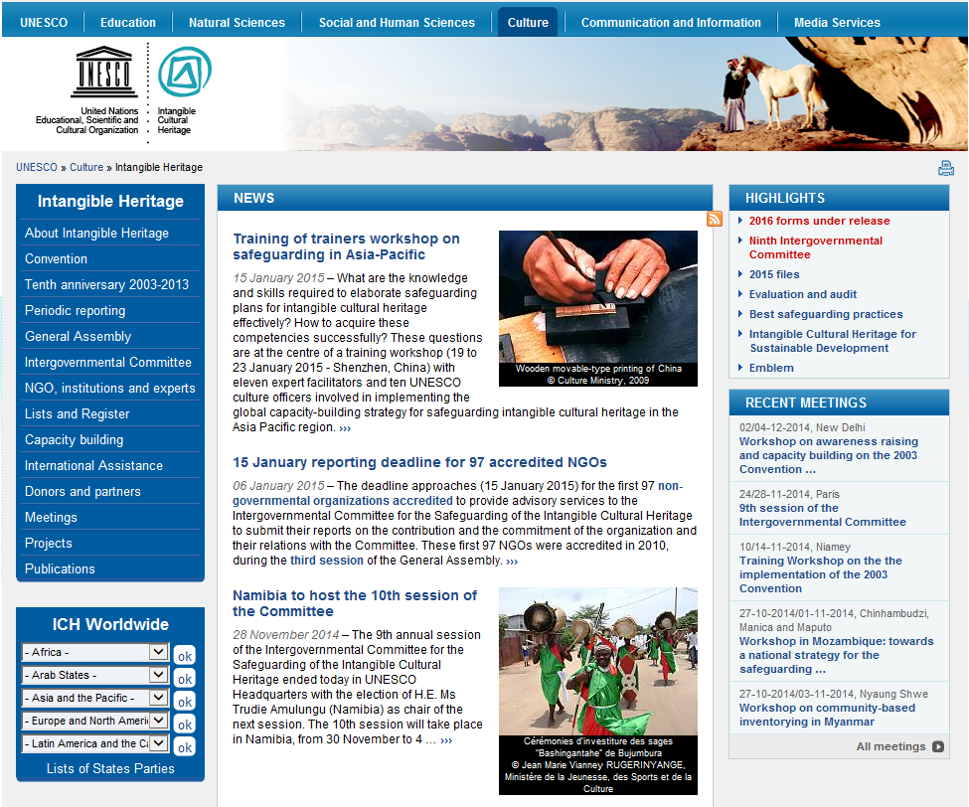
www.unesco.org/culture/ich
f.proschan@unesco.org

