Slide 1
American folk music
“How Can I Keep from Singing?”

Slide 2
american folk music
William Thoms, in 1846, defined folklore as “the traditions, customs, and superstitions of the uncultured classes.”

Slide 3
characteristics
01
Oral tradition & Spiritual
02
Instruments readily available and portable
03
patterned after folk ballads
04
regional
Literacy rate was low in the 1800’s, making memorization necessary. Repetition is key. Songs often contain religious imagery about overcoming trials.
Guitars, banjos, violins, spoons, washboards, flute, etc. -- musicians were always ready to sing and play in gatherings.
Binary (AABB) in poetry these are called couplets; often employs dialogue; simplified language; topics cover include tragedy, humor, love.
Typically found in Appalachia but not exclusive to this area. Others include Cajun, African-American blues, gospel, etc.

Slide 4
Music by Robert Lowry
Arranged by Tim Sharp
How Can I Keep from Singing?

Slide 5
Rhetorical question
The purpose of using a rhetorical question is to get the audience thinking about the topic in different and complex ways.

Slide 6
imagery
My life flows on in endless song;
Above earth’s lamentation.
I hear the sweet, tho’ far-off hymn
That hails a new creation;
Thro’ all the tumult and the strife
I hear the music ringing;
It finds an echo in my soul--
How can I keep from singing?

Slide 7
metaphor
My life flows on in endless song;
Above earth’s lamentation.
I hear the sweet, tho’ far-off hymn
That hails a new creation;
Thro’ all the tumult and the strife
I hear the music ringing;
It finds an echo in my soul--
How can I keep from singing?

Slide 8
Symbolism
What through the tempest loudly roars,
I hear the truth, it live’th
What through the darkness round me close
Songs in the night it give’th
No storm can shake my inmost calm
While to that rock I’m clinging
Since love is lord of Heaven and earth
How can I keep from singing?

Slide 9
Sound devices
What through the tempest loudly roars,
I hear the truth, it live’th
What through the darkness round me close
Songs in the night it give’th
No storm can shake my inmost calm
While to that rock I’m clinging
Since love is lord of Heaven and earth
How can I keep from singing?

Slide 10
Language
What through the tempest loudly roars,
I hear the truth, it live’th
What through the darkness round me close
Songs in the night it give’th
No storm can shake my inmost calm
While to that rock I’m clinging
Since love is lord of Heaven and earth
How can I keep from singing?

Slide 11
dialogue
What through the tempest loudly roars,
I hear the truth, it live’th
What through the darkness round me close
Songs in the night it give’th
No storm can shake my inmost calm
While to that rock I’m clinging
Since love is lord of Heaven and earth
How can I keep from singing?

Slide 12
What story is being told?
This song follows the folk ballad format in rhyme (AABB) and in topic. Folk ballads poignantly strike at the listener’s heart and cause emotional flows. When a performer sings this song, they are, in essence, answering the “How can I keep from singing” question, which is an even larger commentary on the human condition. Despite the suffering that inevitably comes in life, this song affirms our purpose as human beings, which is endure. This, in essence, is the human spirit. Endeavor to persevere.

Slide 13
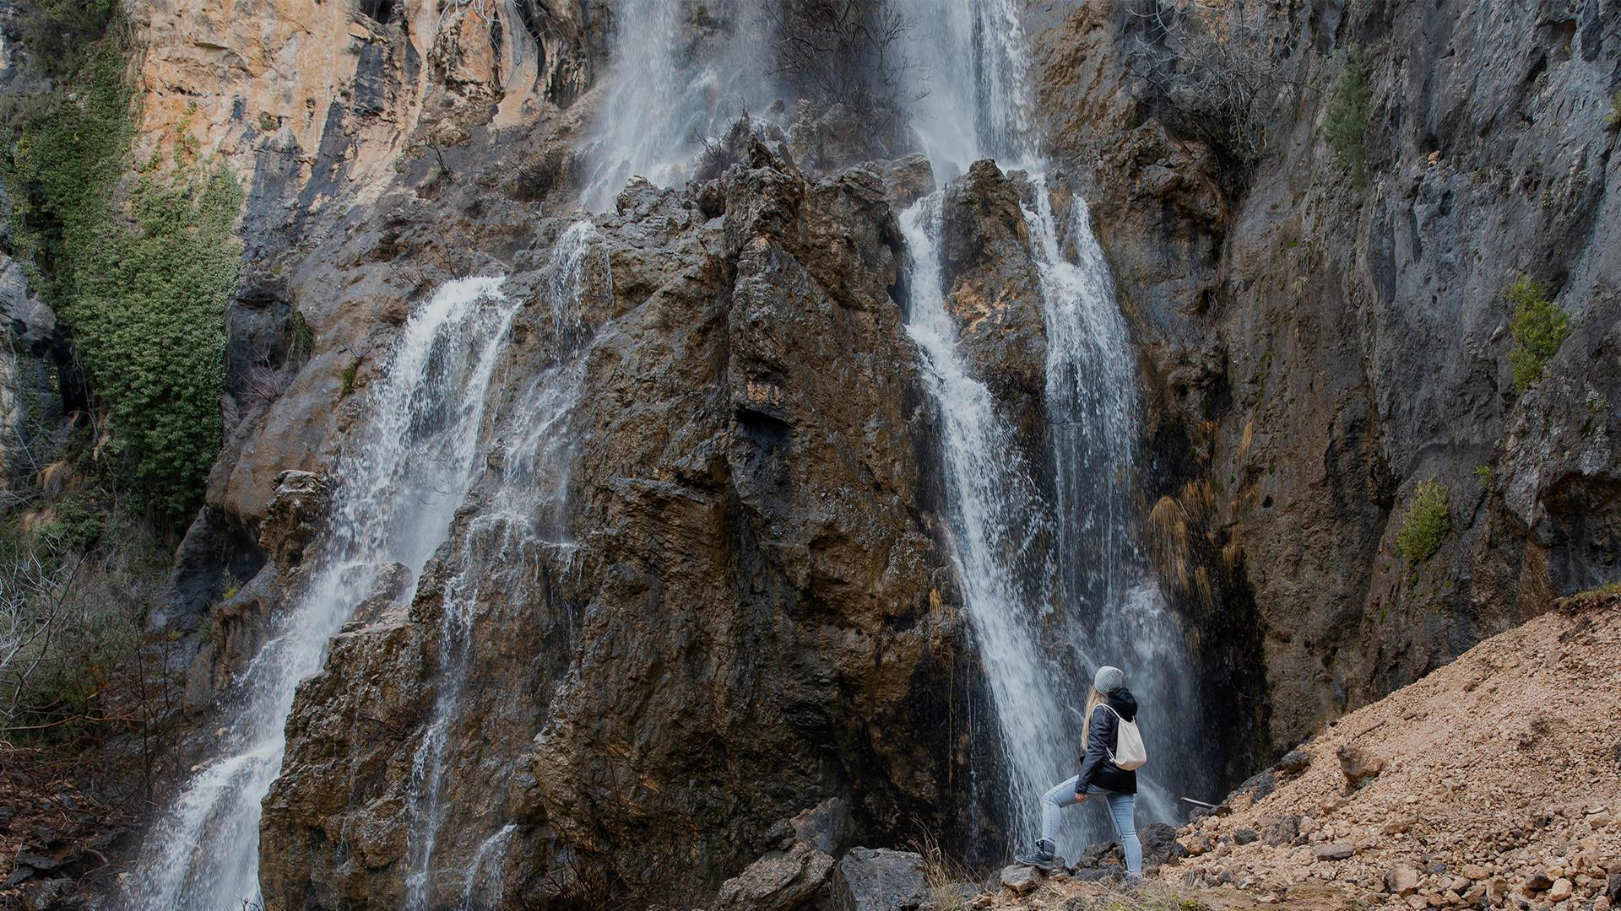
How can i keep from singing?
Want more info?
Irish-Scot

